Slide 1
SC2001 Algorithm Design and Analysis Project 1:
Integration of Merge Sort & Insertion Sort
Presented by: Zheng Wei, Felicia and Qi Yang
Notes:
Good afternoon everyone, I'm Zheng Wei and together with me are Felicia and QiYang. Today, we will share how our group approached this question on Integration of Merge sort and Insertion Sort.

Slide 2
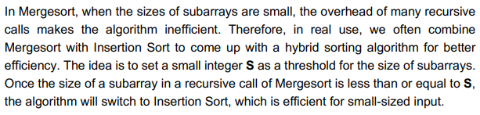
Implementation of Hybrid Algorithm
Notes:
To create the algorithm, we first highlighted the key aspects of it. As stated, the Hybrid Algorithm includes both Insertion Sort and MergeSort with Mergesort occurring as the default until array sizes are less than S where the Hybrid algorithm switches to Insertion Sort.

Slide 3
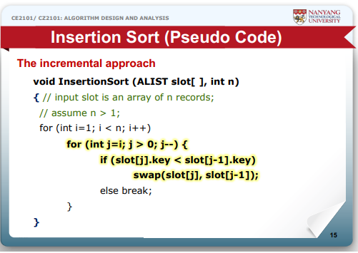

Implementation of Hybrid Algorithm: Insertion Sort Part
Notes:
Her we have the code for Insertion Sort and its time complexity as seen from the lectures. When the array is already sorted, it is the best case with O(n) time complexity. While when the array is reversely sorted, it is the worst case with O(n^2) time complexity.

Slide 4
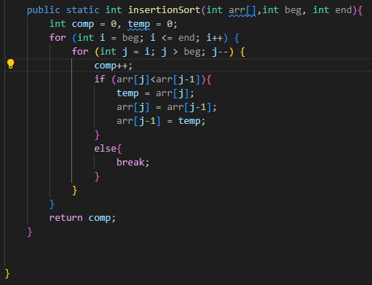
Implementation of Hybrid Algorithm: Insertion Sort Part
Notes:
This is the code we developed for the Insertion Sort part of the algorithm based on the previous slide.

Slide 5
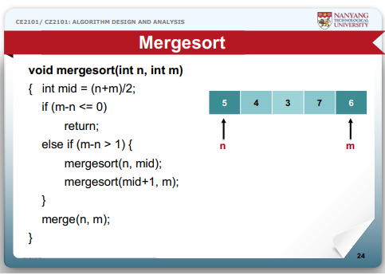
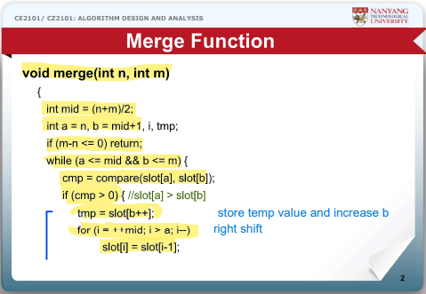
Implementation of Hybrid Algorithm: MergeSort Part
Notes:
This the code for MergeSort as seen from the lectures and…

Slide 6
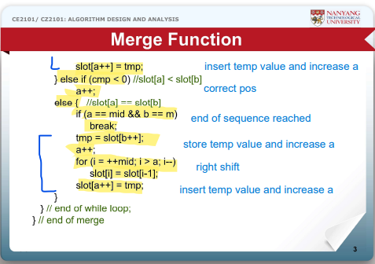
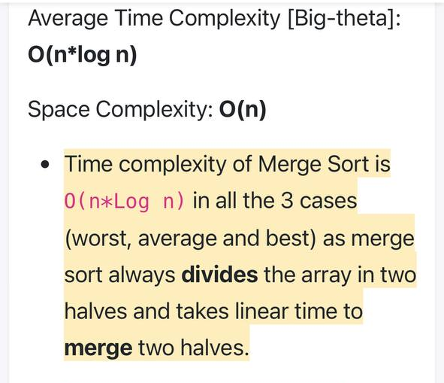
Implementation of Hybrid Algorithm: MergeSort Part
Notes:
…its time complexities of O(n log(n)) which we found online.

Slide 7
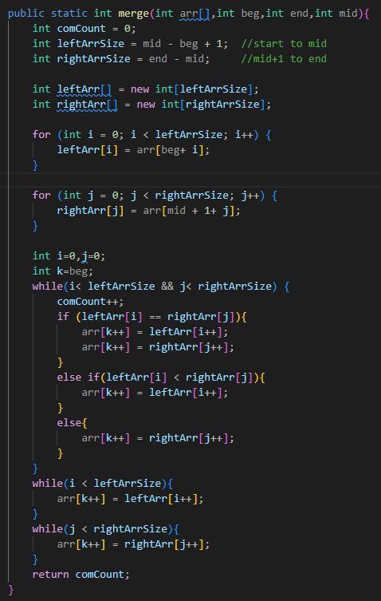
Implementation of Hybrid Algorithm: MergeSort Part
Notes:
This is the code we developed for the merge sort part of the algorithm.

Slide 8
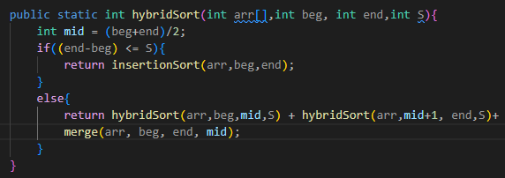
Implementation of Hybrid Algorithm
Notes:
From these informations, we have developed the hybrid sort algorithm as seen here. On the right, the time complexities of the arithmetic mid operation, insertion sort and hybrid sort are shown.

Slide 9
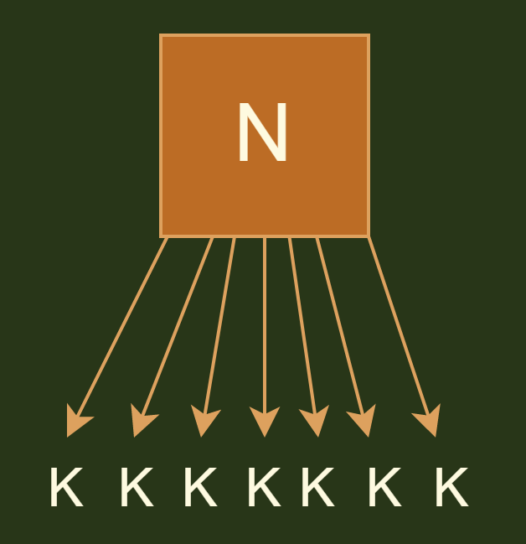
Implementation of Hybrid Algorithm: Division
N/S subarrays of size S
S S S S S S S
Insertion sort done for each subarray

Slide 10
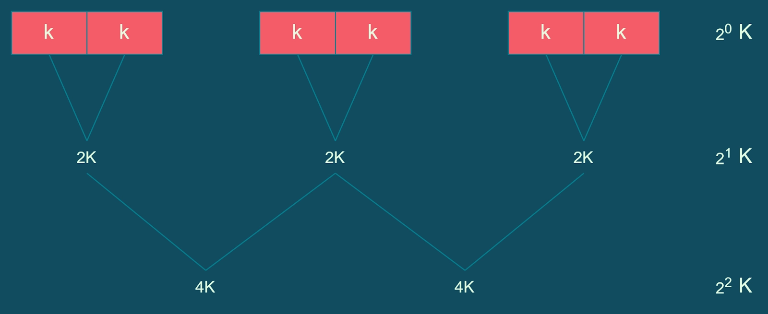
Implementation of Hybrid Algorithm: Merging
S
S
S
S
S
S
2⁰ S
Time complexity Merge(N) is O(N) in worst and best case
Repeat Log2(N/S) times
2S
2S
2S
2¹ S
4S
4S
2² S

Slide 11
Time Complexity of Hybrid Sort
Best Case: O((n/S)(S) + n * log(n/S)) = O(n + n log(n/S))
Worst Case: O((n/S)(S²) + n * log(n/S)) = O(nS + n log(n/S))
Average Case: O((n/S)(S²) + n * log(n/S)) = O(nS + n log(n/S))
Notes:
Given that insertion sort occurs once the array size N is less than S, it will occur on N/S number of arrays which is also N/S times. We also know that the mergesort occurs until N = S. Thus, based on the math on the left and time complexities of insertion sort and merge sort, we derive the following time complexities for hybrid sort.

Slide 12
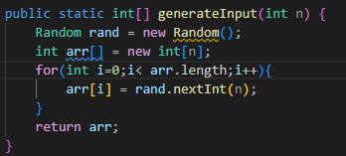
b) Generate Input Data
Notes:
For part b, we used the code shown here to generate a random dataset of integers. The x value we chose as the largest number for the datasets is the same as the size of the array.
Now, I will hand over my time to Felicia to further analyse time complexity based on number of comparisons.

Slide 13
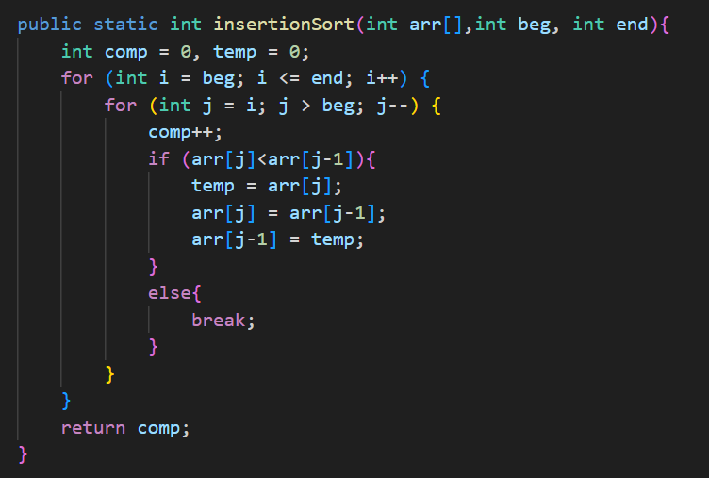
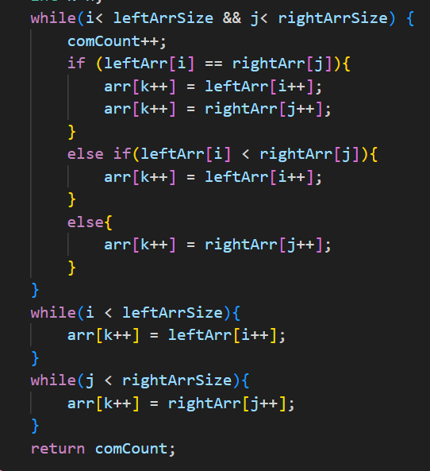
c) Time complexity analysis
insertionSort():
merge():

Slide 14
c) Time complexity analysis
Best Case: O(n + n log(n/S))
Worst Case: O(nS + n log(n/S))
Average Case: O(nS + n log(n/S))

Slide 15
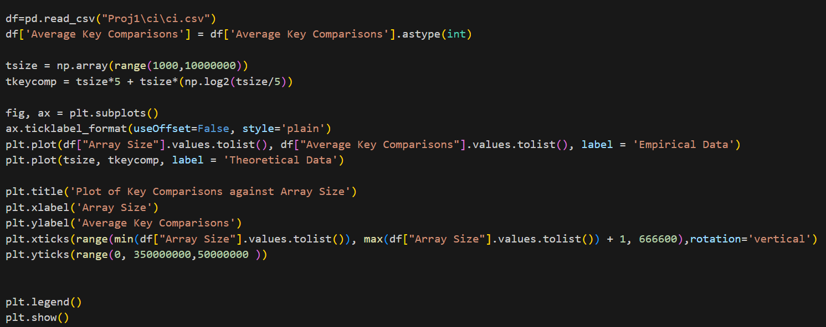
ci) Time complexity analysis: Key Comparisons vs Input size

Slide 16
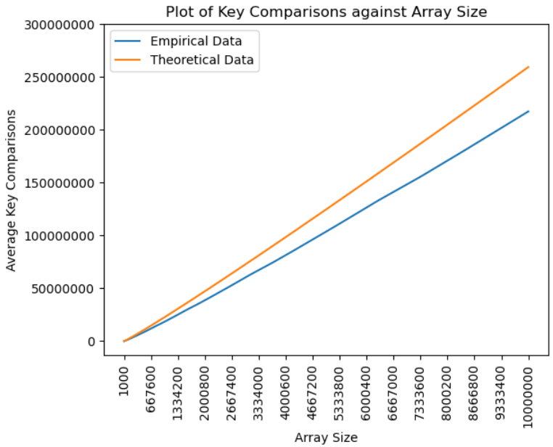
ci) Time complexity analysis: Key Comparisons vs Input size
S=5
Input range: 1000 to 10,000,000
Each point on the graph is the average of 100 random tests
Conclusion
- As S increase, average key comparisons increase
- Graphs grow at relatively same rate

Slide 17
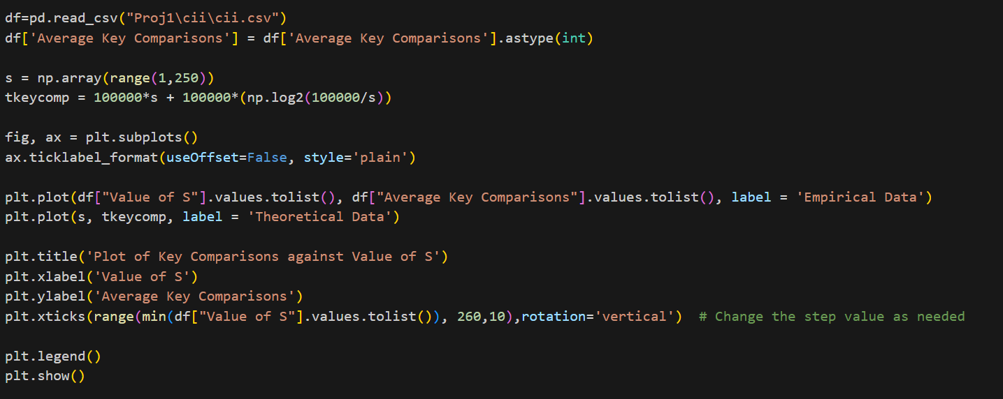
cii) Time complexity analysis: Key Comparisons vs S

Slide 18
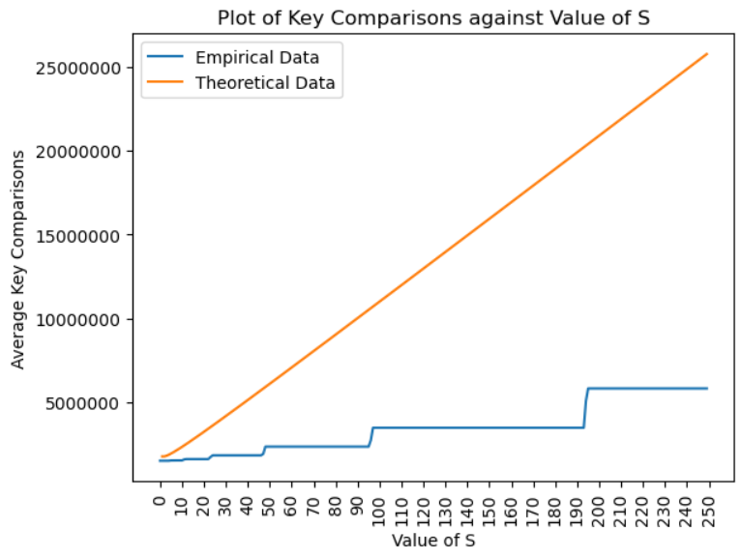
cii) Time complexity analysis: Key Comparisons vs S
n = 100,000
S range: 1 to 250
Each point on the graph is the average of 100 random tests
Conclusion
- As S increase, average key comparisons increase
- Graphs grow at different rate

Slide 19
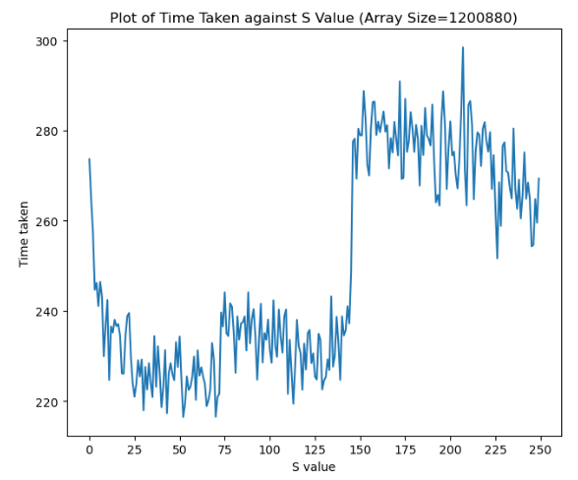
c) (iii) Finding the Optimal Value of S
Example graph:
Optimal Range S[25,75]
Our Optimal Range of S is S[30,55]
Collect data on arraySizes(i) from 1000 to 1,000,000 at increments of 399960
for(i=1000;i<=1,000,000;i+=399960)//iterates 26 times
{
//collect data
}
We test performance of hybridSort for range S[0,250]
Every data point is the average result of 20 random tests
Try to identify a range of S values that would consistently perform optimally across all our array sizes
Optimal range

Slide 20
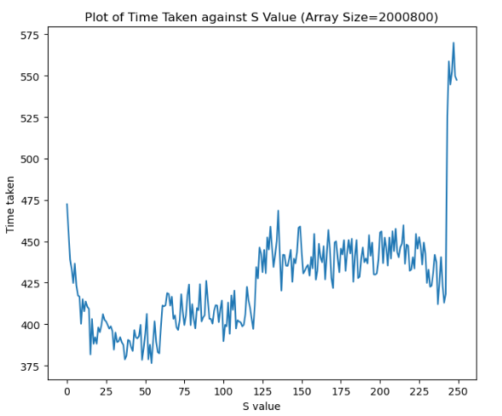
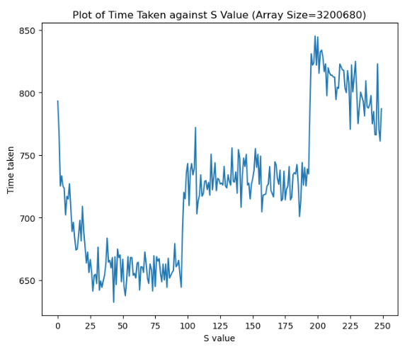
Optimal range
Optimal range
Optimal Range: [13,60]
Optimal Range: [25,95]
In this example if we pick a value of S from [25,60], then hybridsort would have optimal performance in both array sizes. This range is essentially [Highest LowerBound, Lowest UpperBound]
We repeat this process for all 26 array sizes and find that the Optimal range is S[30,55].

Slide 21
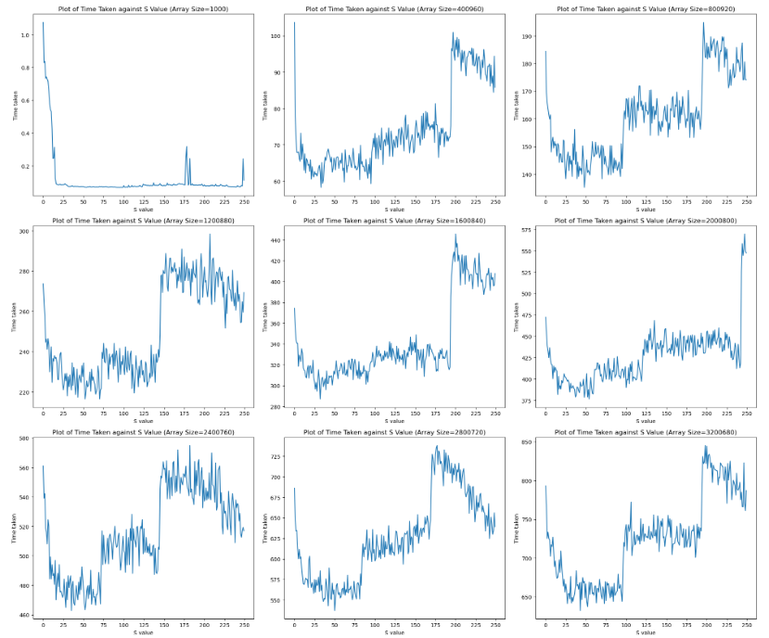
Array sizes 1000 to 3,200,680
This optimal range has lowest upperbound(S=55) of all graphs
Notes:
thank you slide

Slide 22
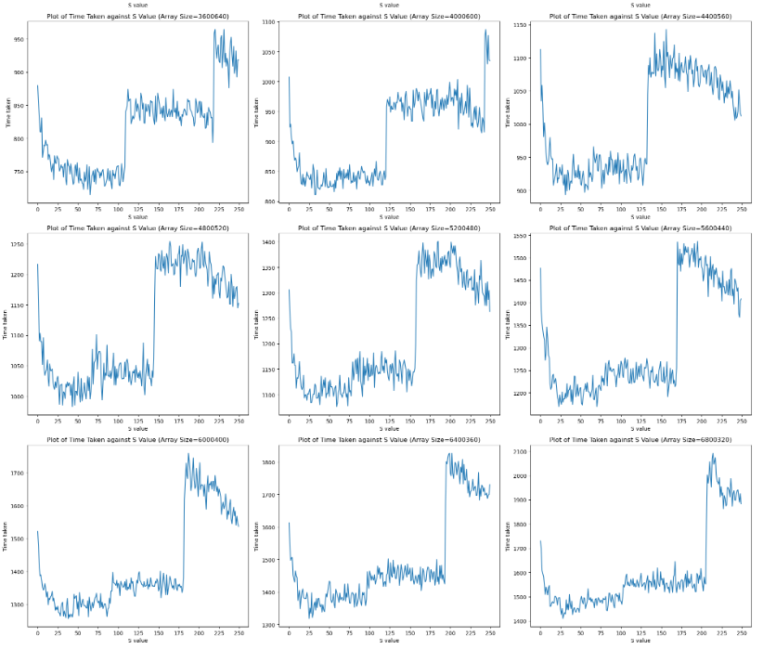
Array sizes 3,600,640 to 6,800,320

Slide 23
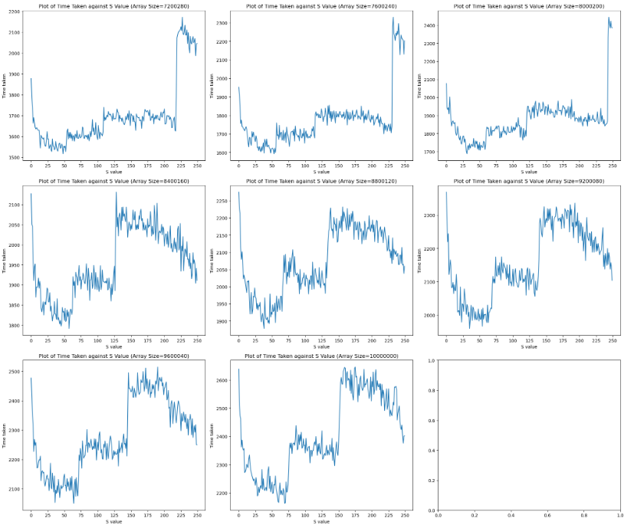
Array sizes 7,200,280 to 10,000,000
This optimal range has highest lowerbound(S=30) of all graphs

Slide 24
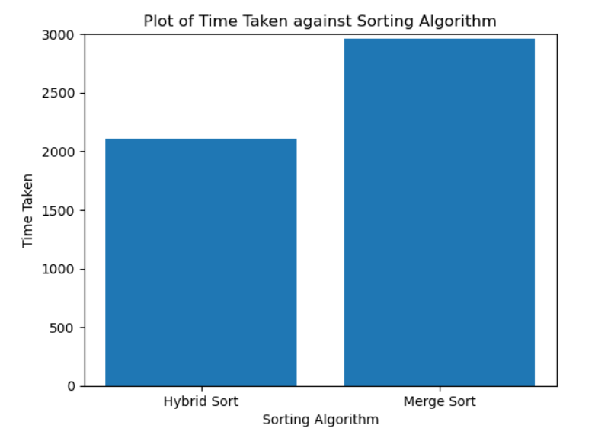
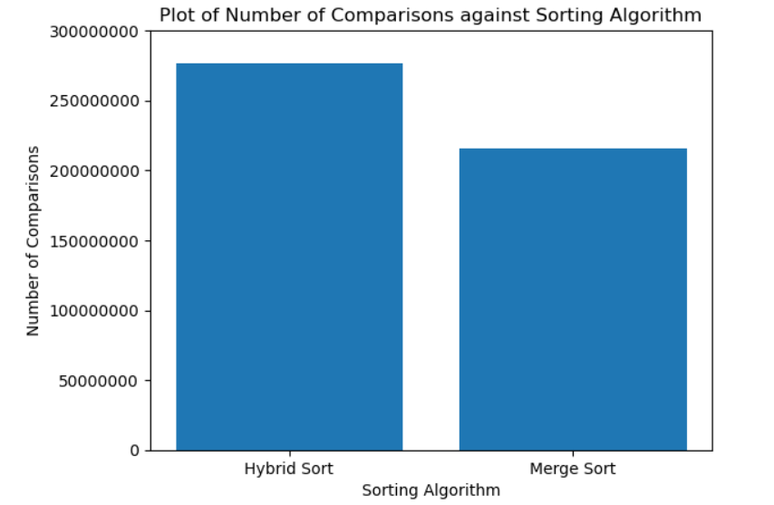
d) Comparing Optimal HybridSort with MergeSort
- We choose S=48. This value is within our optimal range of S[30,55].
- Data is the average collected from 500 random tests
Results:
Hybrid sort has approximately 28.2% more key comparisons than Merge Sort (60905408)
Despite this, Hybrid sort is still significantly faster than Merge sort, at approximately 28.6% faster (847 milliseconds)
2110
2957
/ms
276362182
215456774
2110
2957

Slide 25
Thank you! :D

